Slide 1
Expedia: Hotel Recommendation
Group 9:
Aastha Grover
Neha Gilson
Shuxian Wu

Slide 2
Problem Statement
Expedia has provided logs of customer behavior.
This data includes hotel clusters based on historical price, customer star ratings, geographical locations relative to city center, etc.
They are interested in predicting which hotel group a user is going to book.
Our goal is to predict the booking outcome for a search.

Slide 3
Application Use case
Predict if the search is going to result in a booking. And if so, which cluster will the booked hotel belong to.
Hotel recommendation for a particular search criteria for the US.
Study the travel patterns of users of the website.
Analyze the locations preferred by tourists based on various factors like season, time, vacation etc.

Slide 4
End User
Our model can be used by any travel company like Expedia, Trip Advisor to understand travel patterns of their customers.
They can use it to expand their customer base and market their products and packages based on the results of pattern analysis.

Slide 5
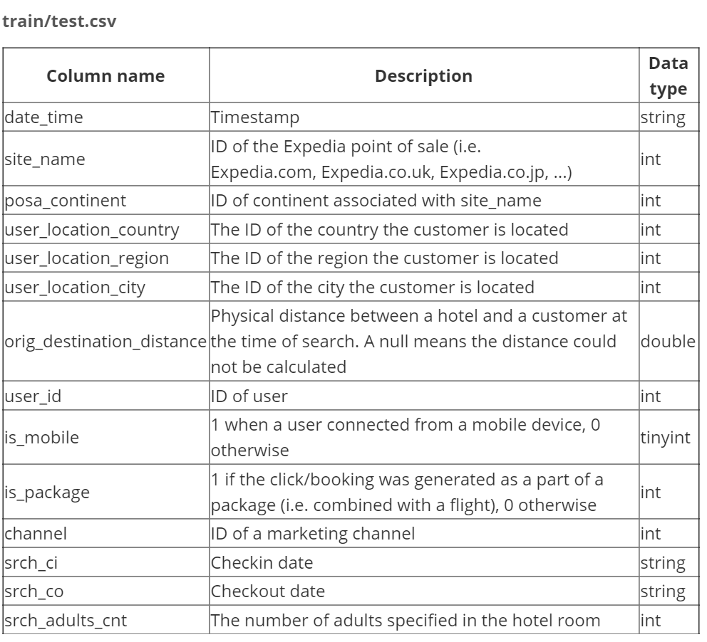
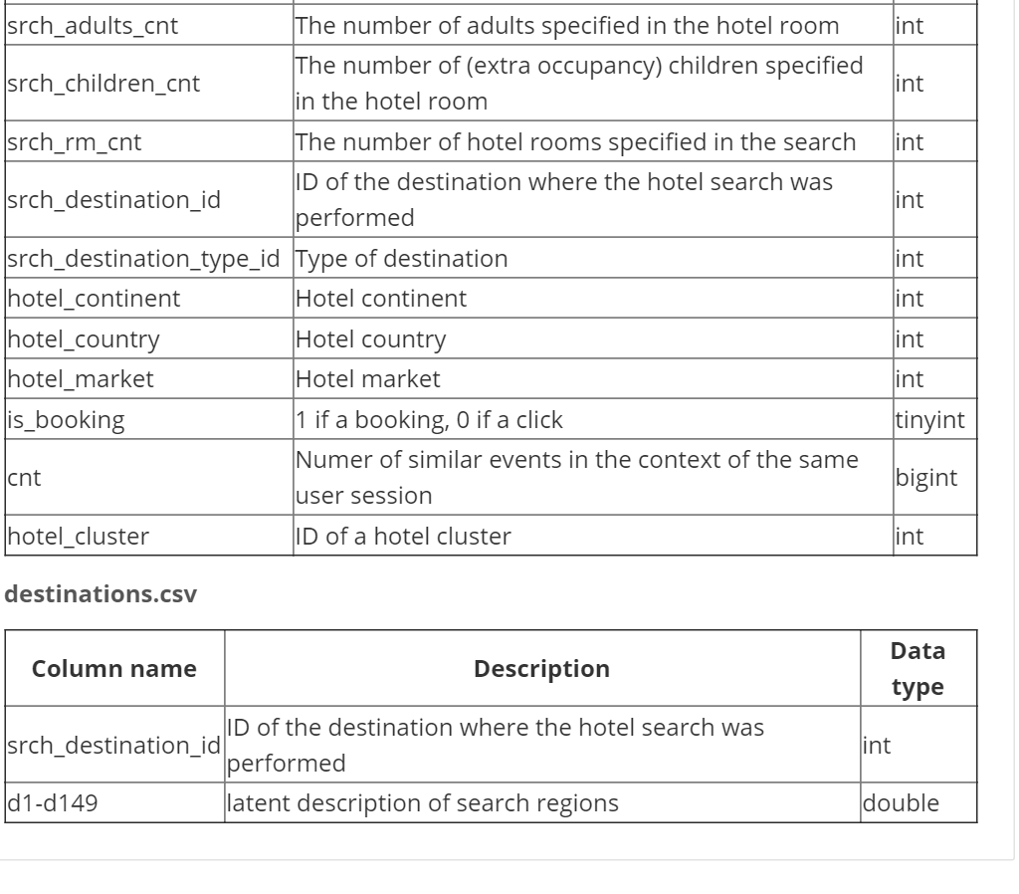
Data Description

Slide 6
Data Aggregation
Python
Data Transformation
Python
Data Cleansing
Python
Model Building
Deploy Model
Visualization
Create Web Service
Azure ML
Azure ML
Tableau
Front End
Spring MVC
Azure ML

Slide 7
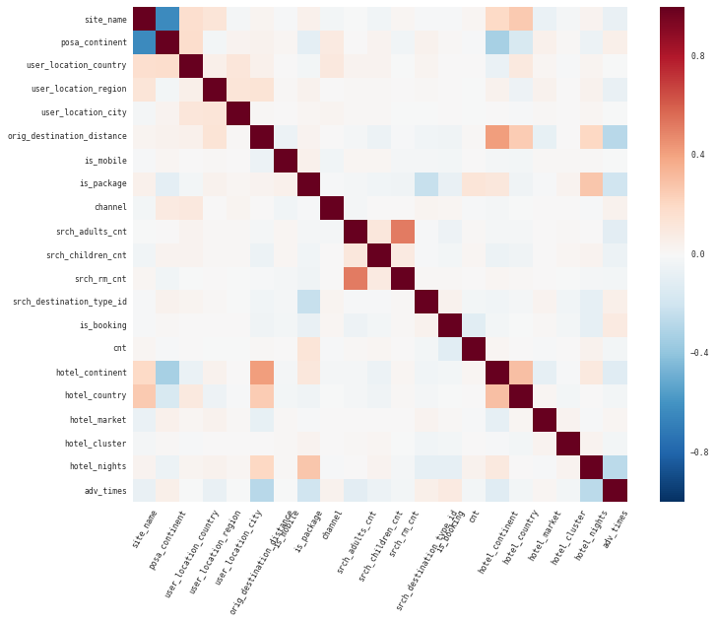
Data Preprocessing

Slide 8
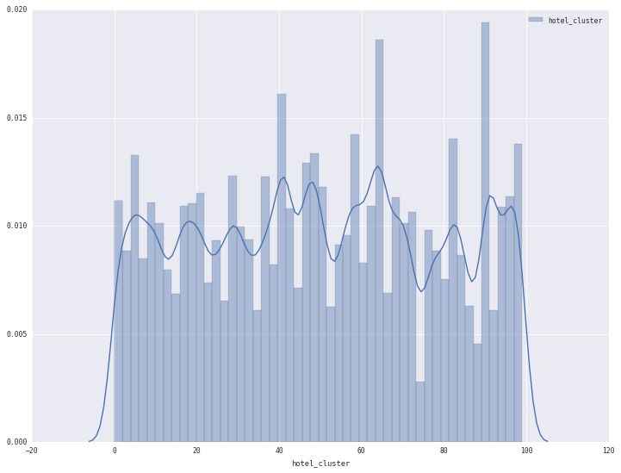
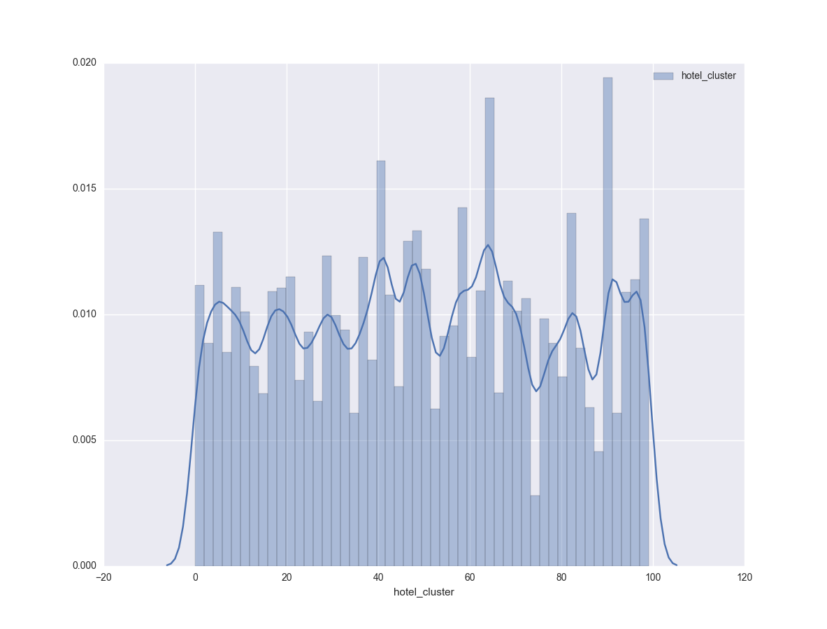
Comparison between original and sample dataset

Slide 9
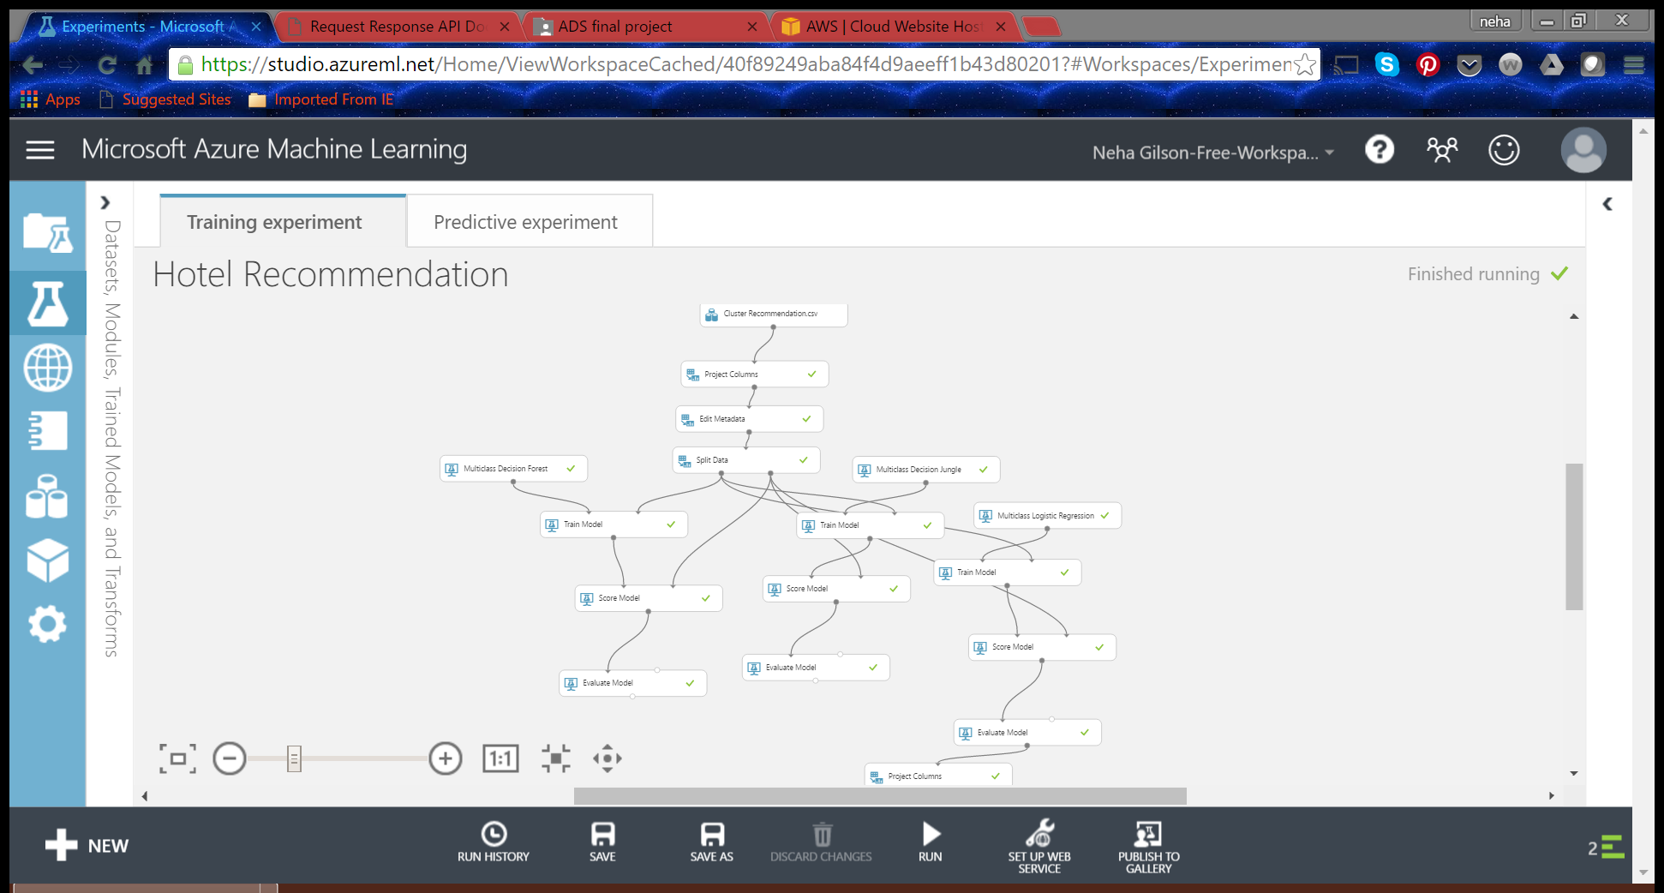
Hotel Recommendation Model

Slide 10
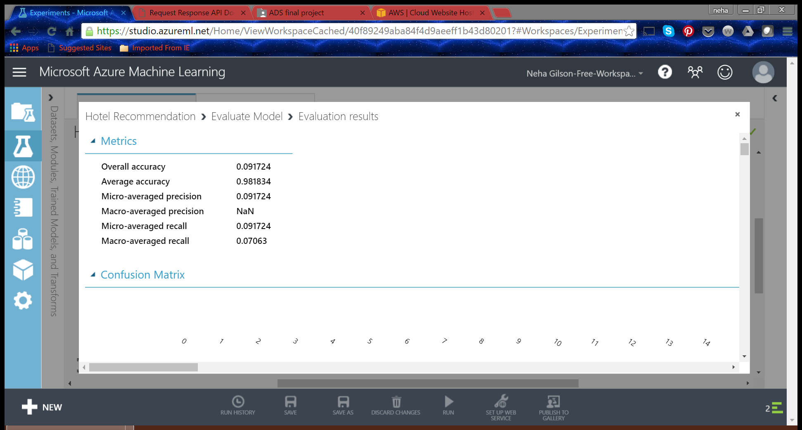
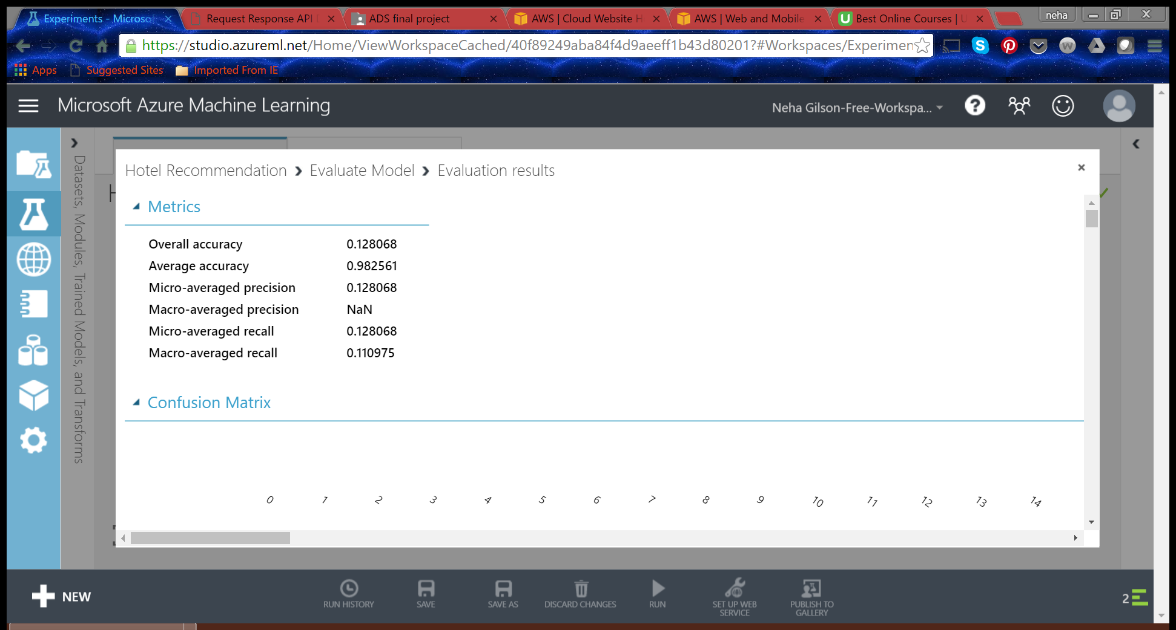

Evaluation
Logistic regression
Decision Forest
Decision Jungle

Slide 11
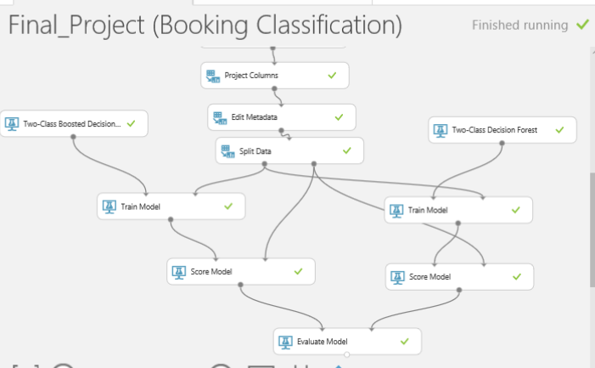
Booking classification

Slide 12
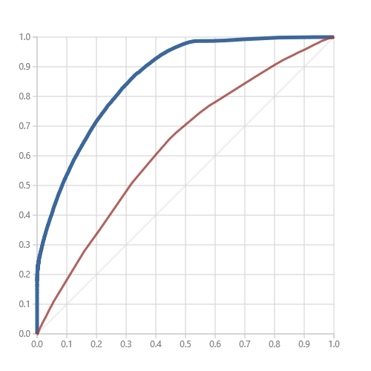
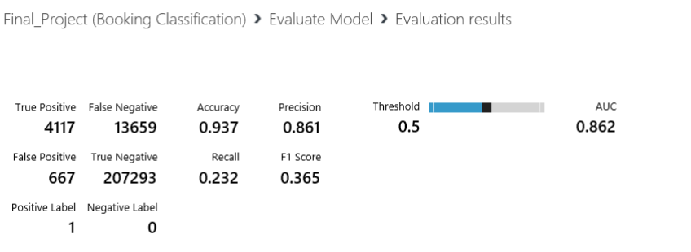
Evaluation
team9ans.pgigtupmik.us-west-2.elasticbeanstalk.com

Slide 13
Questions?
Thank You

